Slide 1


Slide 2
Telecommunicatiesystemen
IP Multicast
Johan Bergs – Jeremy Van den Eynde

Slide 3
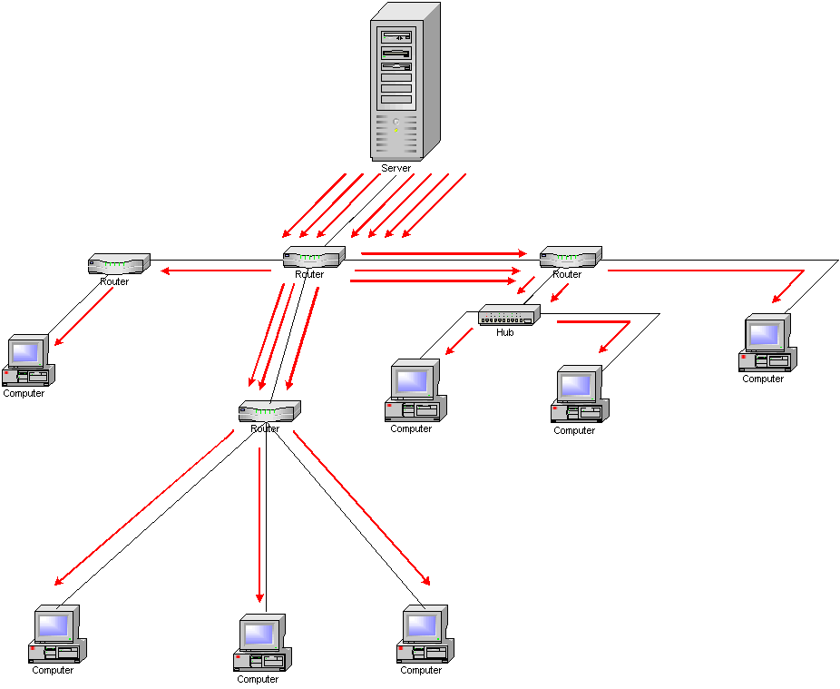
Unicast traffic

Slide 4
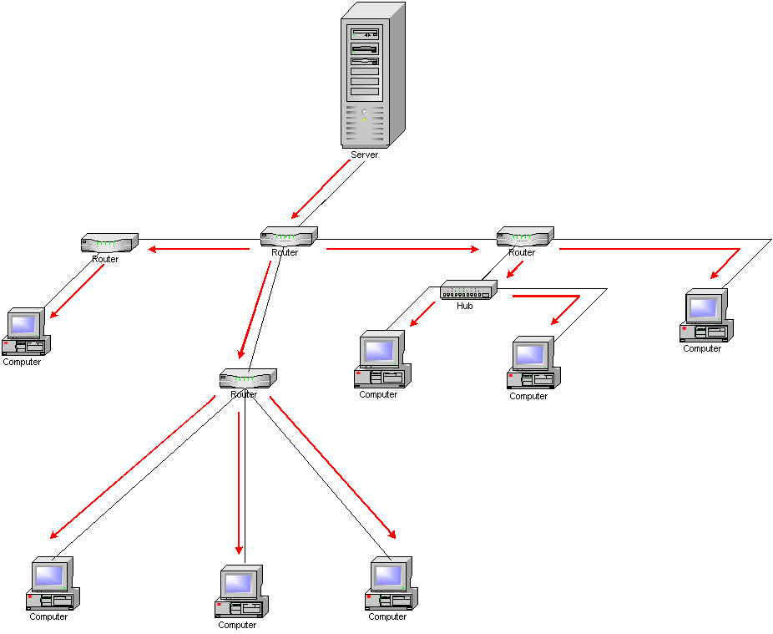
Multicast traffic

Slide 5
Why multicast?
Efficient transmission to multiple receivers
Tree-like optimizations possible
Better bandwidth usage
No duplicate transmission of the same content

Slide 6
Examples
Video streaming / IPTV
Video conferencing
Push software updates

Slide 7
Layer 3 implications
IP multicast traffic: exchanged with group address
Dedicated multicast addresses
Senders and receivers use that address
Receivers join a group
By communication with local routers
Transmitter does not know all of its receivers
Routers
Listen to all IP multicast traffic
Use multicast routing protocols to route it

Slide 8
Multicast IP: 224.0.0.0 – 239.255.255.255
Link local: 224.0.0.0 – 224.0.0.255
224.0.0.1 – all multicast systems on a subnet
224.0.0.2 – all routers on a subnet
Global: 224.0.1.0 – 238.255.255.255
224.0.1.0 – 224.0.1.255 Internetw. control block
224.0.2.0 = 224.0.255.255 AD-HOC block
224.2.0.0 – 224.2.255.255 SDP/SAP
232.0.0.0 – 232.255.255.255 Source specific multicast
233.0.0.0 – 233.255.255.255 GLOP [RFC3180]
Limited scope: 239.0.0.0 – 239.255.255.255
E.g. SURFnet: 239.192.0.0/16

Slide 9
Choosing the group address
Choice is not fixed
A dynamic allocation protocol is missing
Some attempts have been made, but failed
Currently best choice:
Short session: pick random IP within 225.0.0.0 – 231.255.255.255
Longer session
Static allocation within GLOP address space via provider
Source Specifc Multicast (SSM)

Slide 10
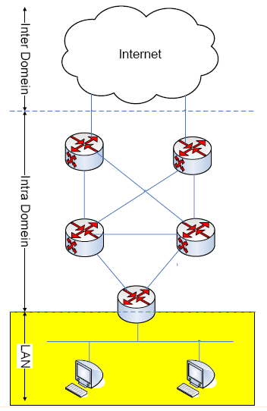
Multicast architecture

Slide 11
Multicast on the LAN: IGMP
Internet Group Management Protocol (IGMP)
Protocol between hosts and routers
Hosts can join and leave multicast groups
IGMPv2
Join and leave by host
IGMPv3
Addition of joining and leaving for specific source

Slide 12
Multicast on the LAN: IGMP
Joining an IP multicast group (225.1.1.1)
Host sends an IGMP report (Join) to the group address 225.1.1.1 to join

Slide 13
Multicast on the LAN: IGMP
Leaving an IP multicast group (225.1.1.1)
Host sends an IGMP report (Leave) to the group address 225.1.1.1 to leave

Slide 14
Multicast on the LAN: IGMP
Keeping an IP multicast group (225.1.1.1) alive
Router sends an IGMP query every 60 seconds
1 host per group answers if there is still someone interested in staying joined with the multicast group
After 2x timeout (~120s), the group is removed

Slide 15
Multicast architecture

Slide 16
IP multicast routing
Build a multicast tree
PIM Sparse-Mode (PIM-SM) is the IP multicast routing protocol for the Internet
Rendezvous Points (RP) are locations where senders and receivers meet
Senders are ’registered’ by the the routing protocol by the local router
Local routers register receivers wishing to subscribe to the multicast flow

Slide 17
IP multicast routing
PIM-SM via RP (shared tree)

Slide 18
IP multicast routing
PIM-SM via shortest path tree

Slide 19
IP multicast routing
Adding a receiver to the PIM-SM tree

Slide 20
IP multicast routing – PIM-SSM
PIM-SSM (Source Specific Multicast) is a subset of the PIM-SM protocol
It is meant for one-to-many multicasts (e.g. IPTV)
Uses the shortest path tree algorithm
No need for Rendezvous Points
IGMPv3 is needed between the receiver and the local router

Slide 21
IP multicast routing
PIM-SSM

Slide 22
IP multicast routing

Slide 23
Multicast architecture

Slide 24
Inter domain IP multicast
Multicast Source Discovery Protocol (MSDP)
Exchange information on multicast sources and subscriptions between rendezvous points

Slide 25
Summary
IP multicast
Can reduce bandwidth for one-to-many, many-to-many and many-to-one communication
Can be supported on three levels
Local (IGMP)
Intra-domain (PIM-SM)
Inter-domain (MSDP)

